Slide 1
CSE 3200: System Development Project Human Activity Recognition
Supervised By:
S. M. Taslim Uddin Raju
Lecturer
Department of Computer Science and Engineering
Submitted By:
1. Saimoon Al Farshi Oman
Roll: 1807018
2. MD. Nafis Jamil
Roll: 1807054
3rd Year, 2nd Semester
Khulna University of Engineering and Technology

Slide 2
Contents of Presentation
Introduction
Objective
Motivation
Key Idea
Methodology
Implementation
Application
Future Scope For Improvement
Conclusion
Reference

Slide 3
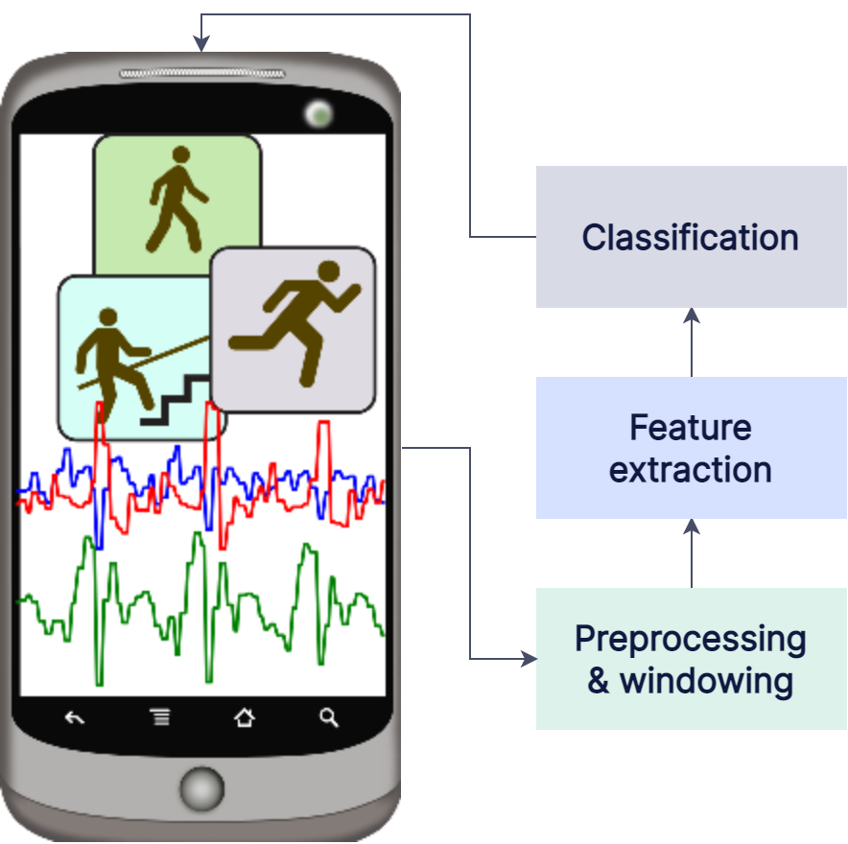
Introduction:
Human activity recognition, or HAR for short, is a process of interpreting specific human motion based on sensor data
As smartphone[1] is embedded with senor, we use smartphone to collect sensor data.

Slide 4
Objectives:
To build a Deep Neural Network model for Human Activity Recognition
To build a real-time HAR based Android Application
To integrate HAR into a human centric application e.g Elderly Monitoring System.

Slide 5
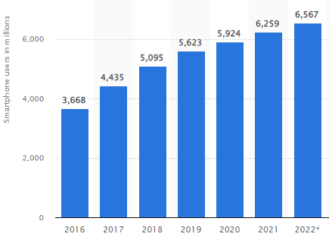
Motivation:
There is vast availability of smartphones equipped with multiple sensors
According to Statista[2], the current number of smartphone users in the world today is 6.569 billion, means that 83.32% of world population owns a smartphone.

Slide 6
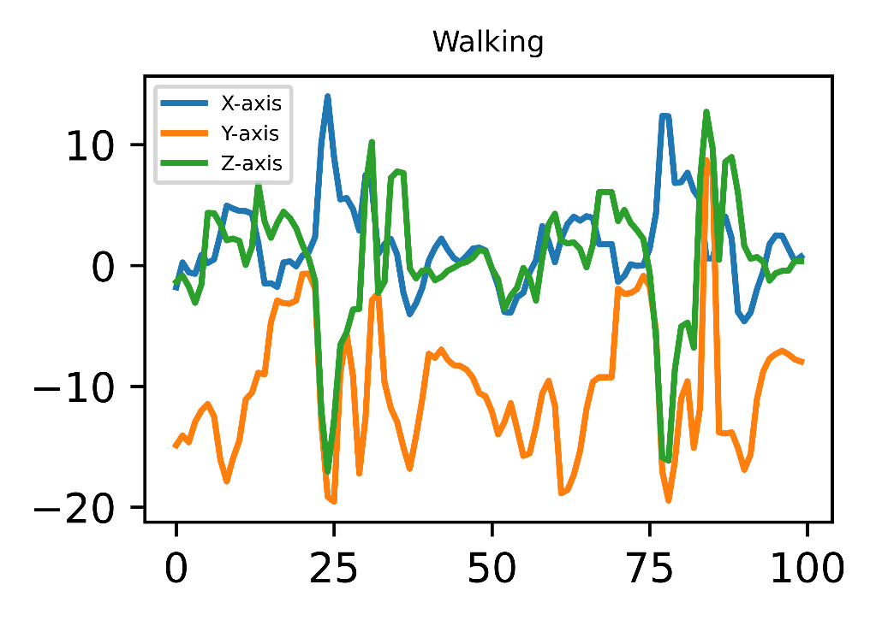
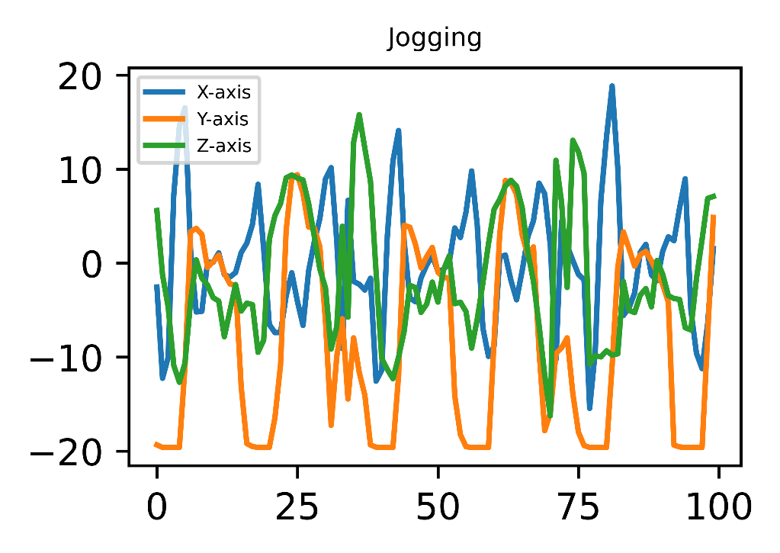
Key Idea:
Smartphone sensors data for different activity

Slide 7
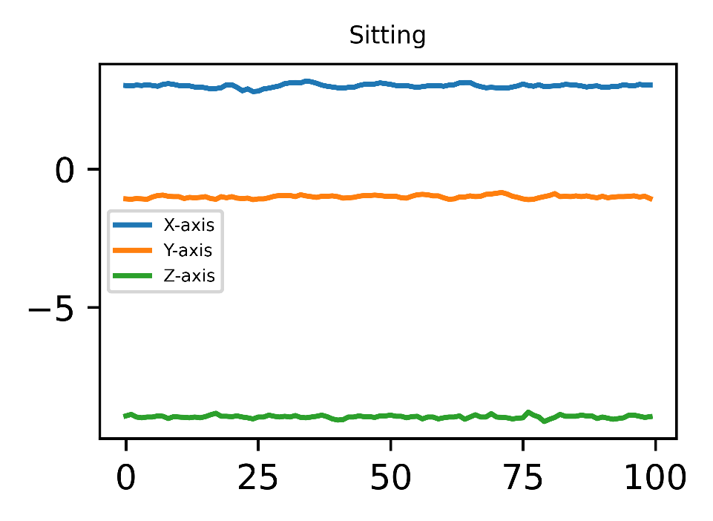
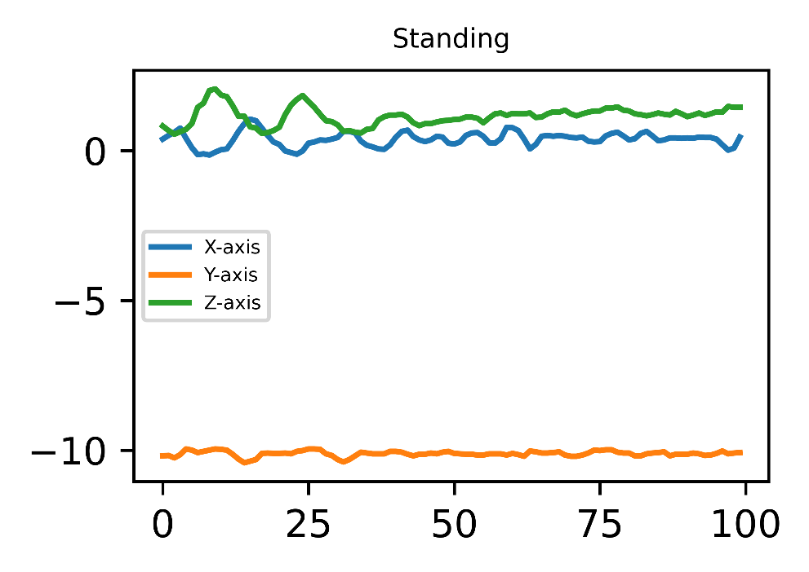
Key Idea – Cont’d:
As sensor data is changing for different activity
So, the key idea is to build a model that can recognize human activity by distinguishing between sensor data

Slide 8
Methodology:
Methodology is described in 4 section:
Dataset Collection
Data Preprocessing
Construct a Model
Performance Validation

Slide 9
Methodology – Cont’d :
Dataset Collection:
Dataset was collected from University of Twente’s Pervasive Systems research section
Ten participants performed the data collection task
Data is collected from an accelerometer, a gyroscope, a magnetometer and a linear acceleration sensor upon 7 physical activities
Walking
Sitting
Standing
Jogging
Biking
Walking upstairs
Walking downstairs

Slide 10
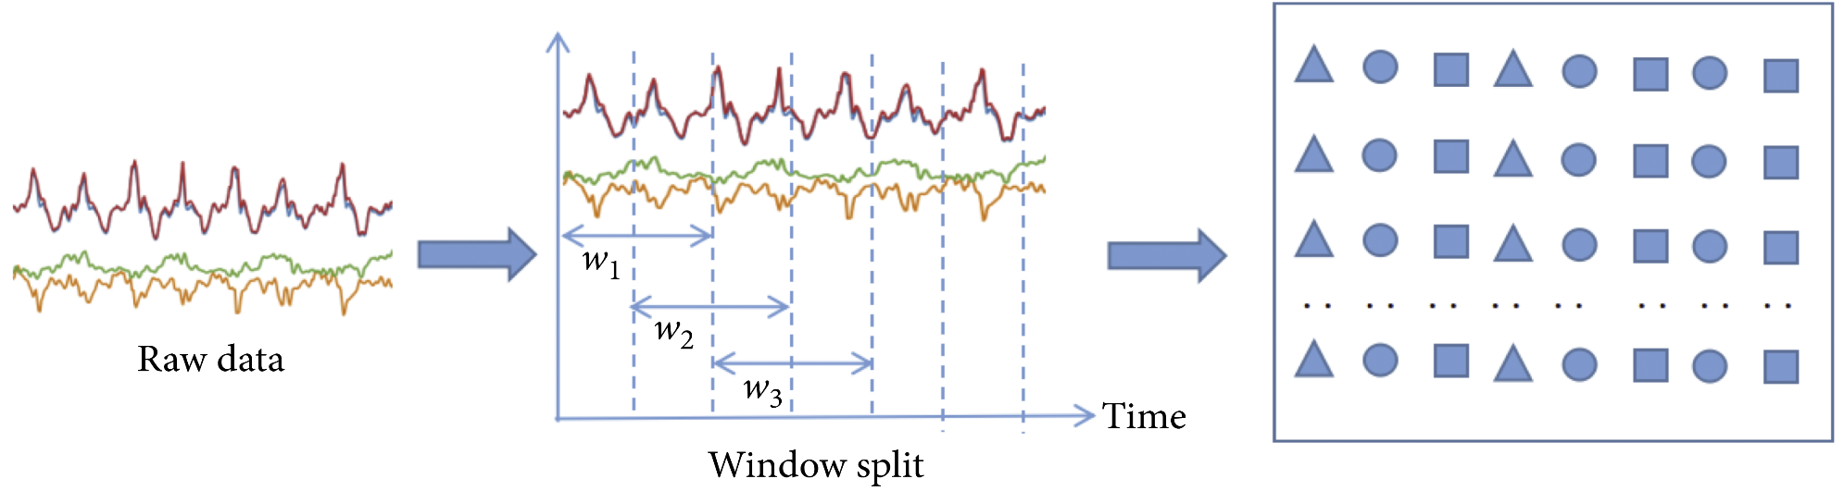
Methodology – Cont’d :
Data Preprocessing:
To recognize an activity a sequence of sensor data is needed.
So, sliding window[3] segment with 50% overlap was carried out with a window size of 100

Slide 11
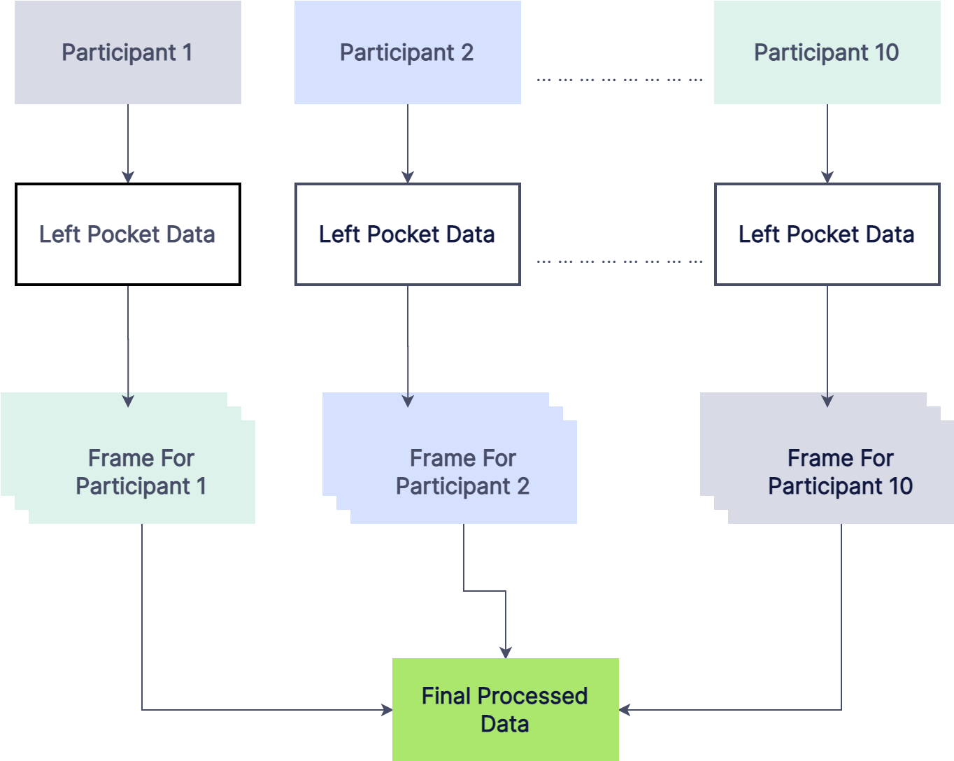
Methodology – Cont’d :

Slide 12
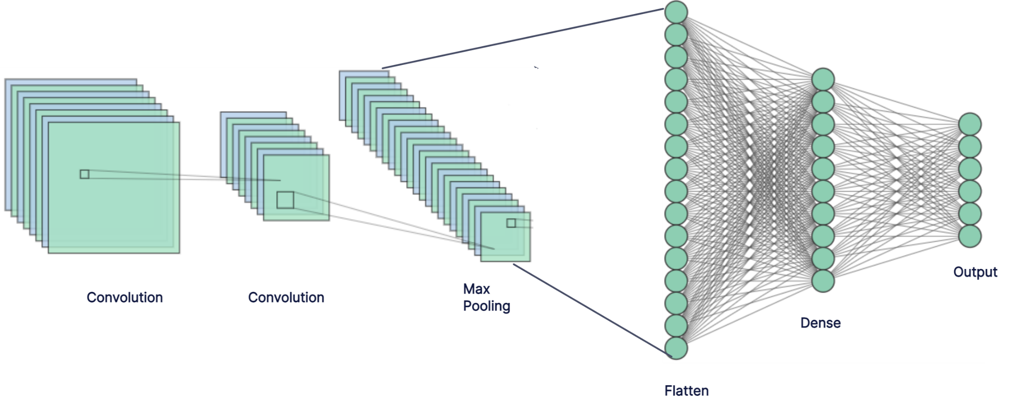
Methodology – Cont’d :
Construct a Model:

Slide 13
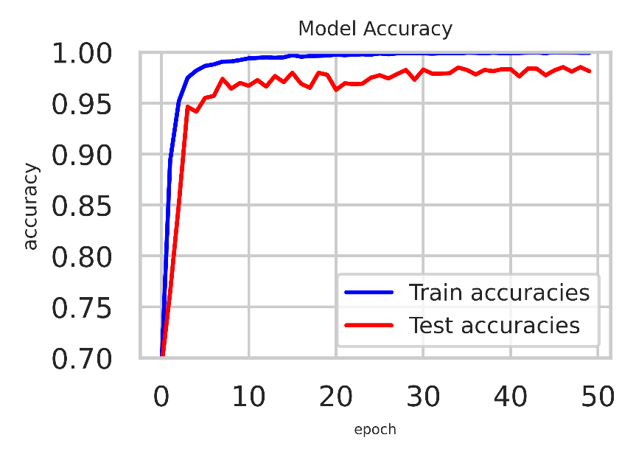
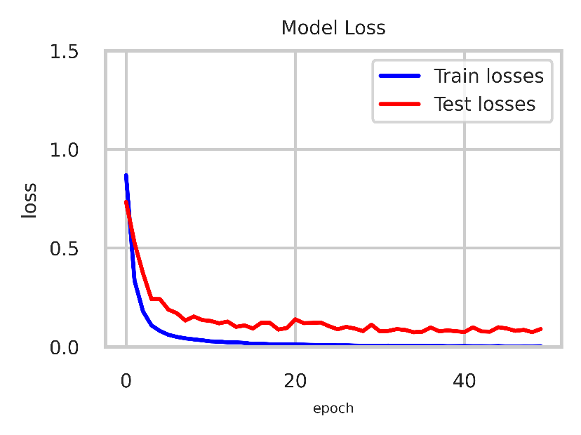
Methodology – Cont’d :
Performance Validation:
Test Accuracy : 98%
Test Loss : 0.08%

Slide 14
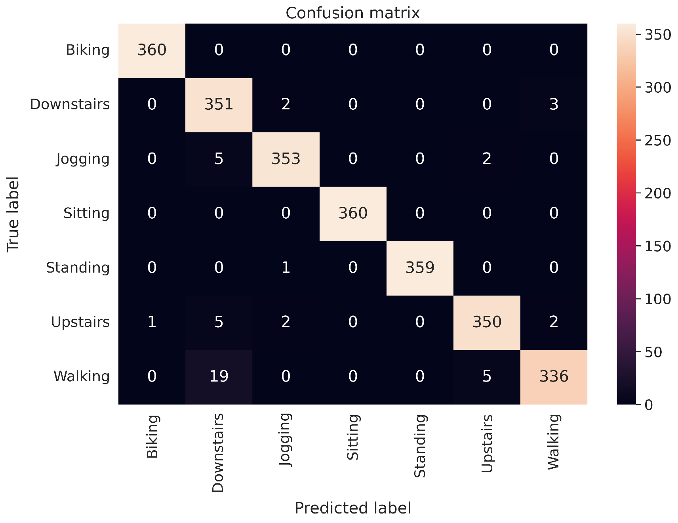
Methodology – Cont’d :

Slide 15
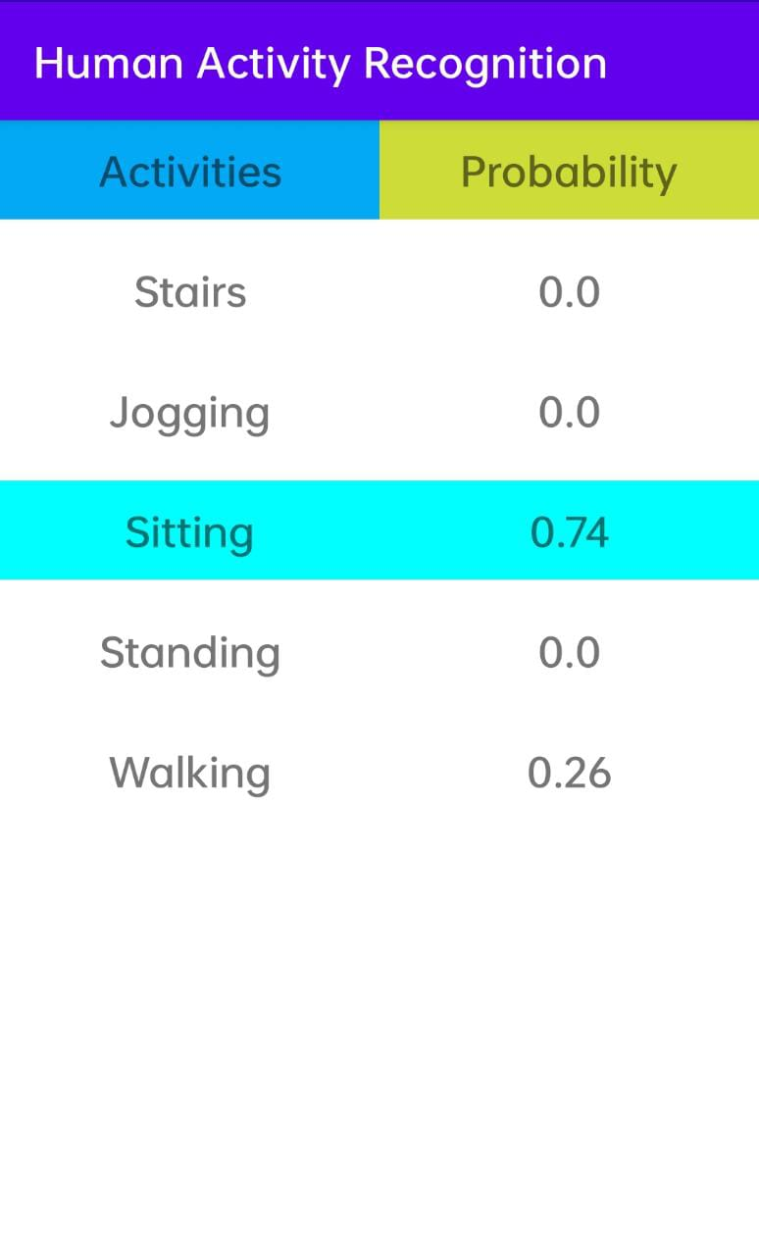
Implementation:
Front-end:

Slide 16
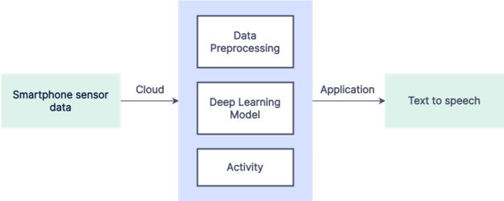
Implementation – Cont’d :
Networking-API:
Okhttp library version 4.9 [4]
Back-end:
Python based flask
Tensorflow library
Keras library

Slide 17
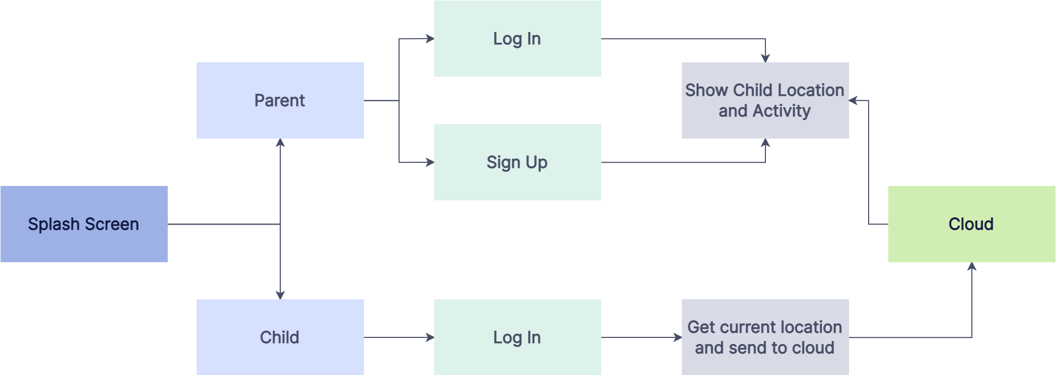
Application
Elderly Monitoring System

Slide 18
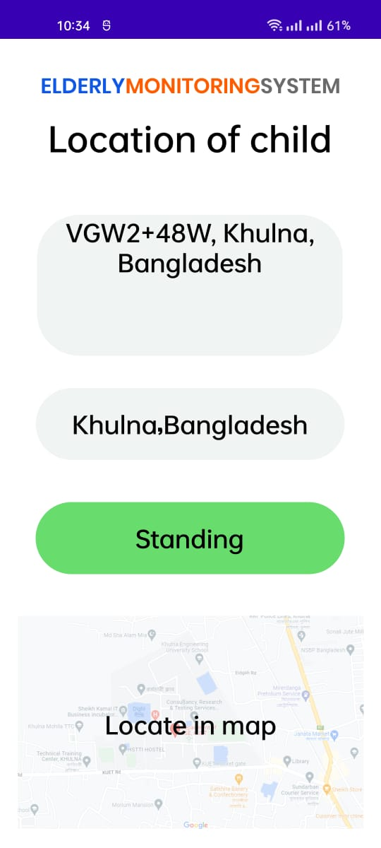
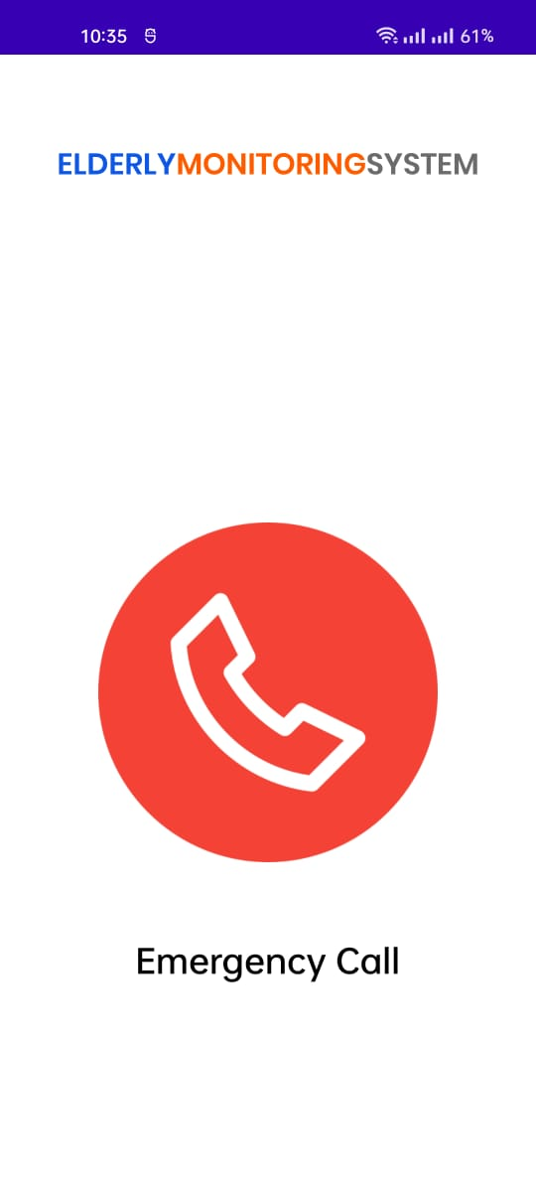
Application – Cont’d :
Parent Screen
Child Screen

Slide 19
Future scope for improvement:
Improve accuracy for similar activities such as walking, stairs etc.
Compatibility for different device orientations
Such as left hand, right hand, left pocket, right pocket, back pocket
Compatibility for different device positions

Slide 20
Conclusion:
Our system successfully recognizes physical activities such as standing, sitting, walking and jogging
It faces difficulties distinguishing similar activities like walking and walking stairs
Human Activity Recognition has enormous potential on human centric applications notably in eldercare and healthcare.

Slide 21
References:
https://www.semanticscholar.org/paper/Robust-smartphone-based-human-activity-recognition-Torres-Huitzil-Nu%C3%B1o-Maganda/
https://www.statista.com/statistics/330695/number-of-smartphone-users-worldwide/
https://www.hindawi.com/journals/scn/2020/2132138/?fbclid=IwAR0fzr2wy_vyRf61f_oPriXY00HaujRWjXME3bTfDJ7waIb4H3e2GX6c-x8
https://square.github.io/okhttp/

Slide 22
Thank You

Slide 23

App Demonstration:

